Slide 1
Chapter 3: Graphs
Fall 2013
Prof. Peng-Jun Wan

Slide 2
3.1 Basic Definitions and Applications
[Adapted from slides by Kevin Wayne.]

Slide 3
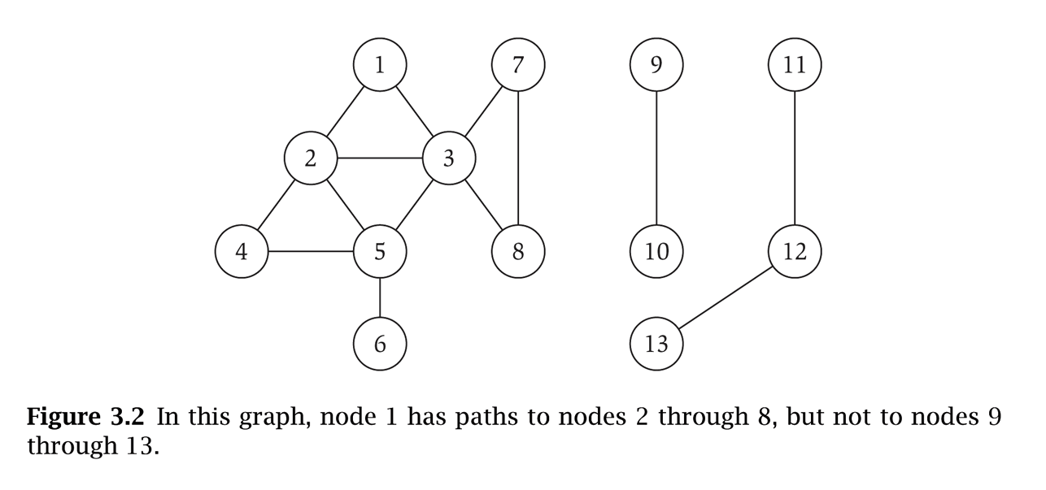
Undirected Graphs
Undirected graph. G = (V, E)
  V = nodes.
  E = edges between pairs of nodes.
  Captures pairwise relationship between objects.
  Graph size parameters: n = |V|, m = |E|.
V = { 1, 2, 3, 4, 5, 6, 7, 8 }
E = { 1-2, 1-3, 2-3, 2-4, 2-5, 3-5, 3-7, 3-8, 4-5, 5-6 }
n = 8
m = 11

Slide 4
Some Graph Applications
Graph
Nodes
Edges
transportation
street intersections
highways
communication
computers
fiber optic cables
World Wide Web
web pages
hyperlinks
social
people
relationships
food web
species
predator-prey
software systems
functions
function calls
scheduling
tasks
precedence constraints
circuits
gates
wires

Slide 5
World Wide Web
Web graph.
  Node: web page.
  Edge: hyperlink from one page to another.
cnn.com
netscape.com
novell.com
cnnsi.com
timewarner.com
hbo.com
sorpranos.com

Slide 6
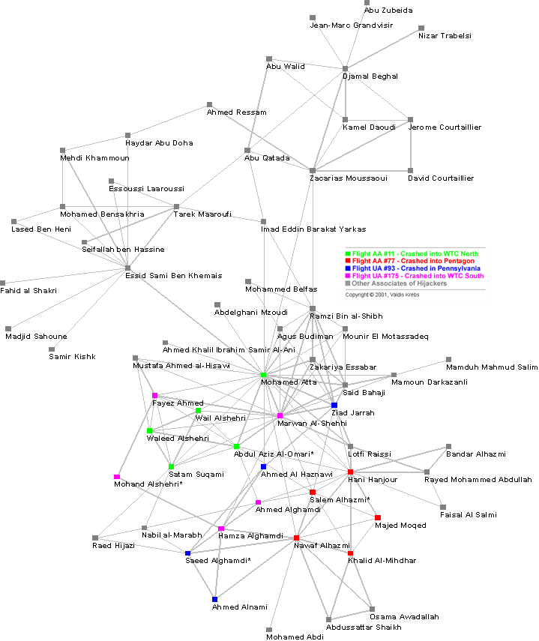
9-11 Terrorist Network
Social network graph.
  Node: people.
  Edge: relationship between two people.
Reference: Valdis Krebs, http://www.firstmonday.org/issues/issue7_4/krebs

Slide 7
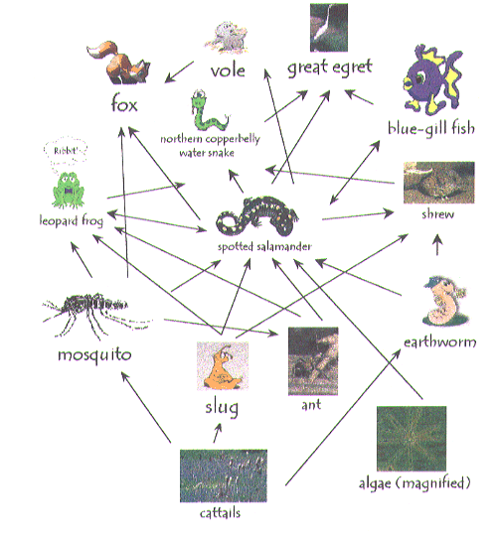
Ecological Food Web
Food web graph.
  Node = species.
  Edge = from prey to predator.
Reference: http://www.twingroves.district96.k12.il.us/Wetlands/Salamander/SalGraphics/salfoodweb.giff

Slide 8
Graph Representation: Adjacency Matrix
Adjacency matrix. n-by-n matrix with A_{uv} = 1 if (u, v) is an edge.
  Two representations of each edge.
  Space proportional to n².
  Checking if (u, v) is an edge takes Θ(1) time.
  Identifying all edges takes Θ(n²) time.
1 2 3 4 5 6 7 8
1 0 1 1 0 0 0 0 0
2 1 0 1 1 1 0 0 0
3 1 1 0 0 1 0 1 1
4 0 1 0 1 1 0 0 0
5 0 1 1 1 0 1 0 0
6 0 0 0 0 1 0 0 0
7 0 0 1 0 0 0 0 1
8 0 0 1 0 0 0 1 0

Slide 9
Graph Representation: Adjacency List
Adjacency list. Node indexed array of lists.
  Two representations of each edge.
  Space proportional to m + n.
  Checking if (u, v) is an edge takes O(deg(u)) time.
  Identifying all edges takes Θ(m + n) time.
degree = number of neighbors of u
1
2
3
2
1
3
4
5
3
1
2
5
7
8
4
2
5
5
2
3
4
6
6
5
7
3
8
8
3
7

Slide 10
Paths and Connectivity
Def. A path in an undirected graph G = (V, E) is a sequence P of nodes v₁, v₂, …, v_{k-1}, v_{k} with the property that each consecutive pair v_{i}, v_{i+1} is joined by an edge in E.
Def. A path is simple if all nodes are distinct.
Def. An undirected graph is connected if for every pair of nodes u and v, there is a path between u and v.

Slide 11
Cycles
Def. A cycle is a path v₁, v₂, …, v_{k-1}, v_{k} in which v₁ = v_{k}, k > 2, and the first k-1 nodes are all distinct.
cycle C = 1-2-4-5-3-1

Slide 12
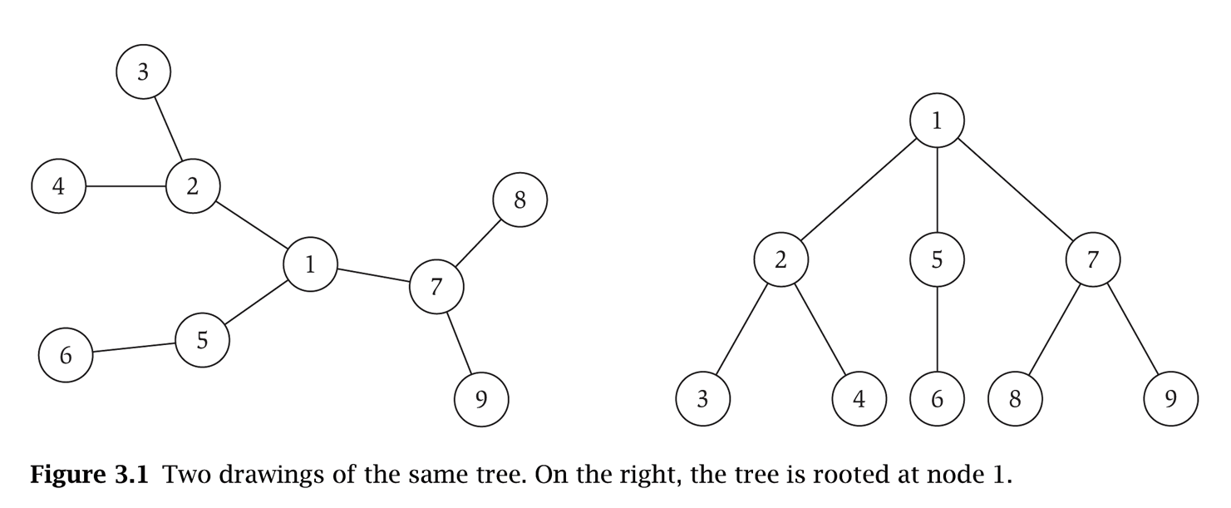
Trees
Def. An undirected graph is a tree if it is connected and does not contain a cycle.
Theorem. Let G be an undirected graph on n nodes. Any two of the following statements imply the third.
  G is connected.
  G does not contain a cycle.
  G has n-1 edges.

Slide 13
Rooted Trees
Rooted tree. Given a tree T, choose a root node r and orient each edge away from r.
Importance. Models hierarchical structure.
root r
parent of v
v
child of v
a tree
the same tree, rooted at 1
Notes:
by rooting a tree, it's easy to see that it has n-1 edges (exactly one edge leading upward from each non-root node.)

Slide 14
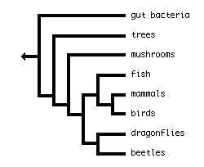
Phylogeny Trees
Phylogeny trees. Describe evolutionary history of species.
Notes:
biologists draw their tree from left to right
The phylogeny states that there was an ancestral species that gave rise to mammals and birds, but not to the other species shown in the tree (that is, mammals and birds share a common ancestor that they do not share with other species on the tree), that all animals are descended from an ancestor not shared with mushrooms, trees, and bacteria, and so on.

Slide 15
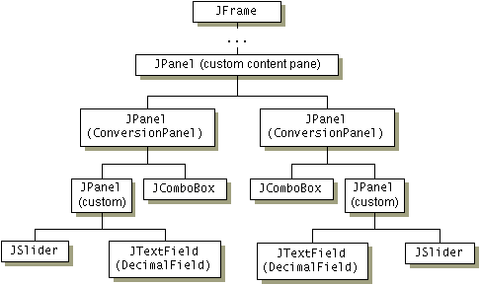
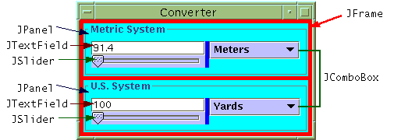
GUI Containment Hierarchy
GUI containment hierarchy. Describe organization of GUI widgets.
Reference: http://java.sun.com/docs/books/tutorial/uiswing/overview/anatomy.html

Slide 16
3.2 Graph Traversal

Slide 17
Connectivity
s-t connectivity problem. Given two node s and t, is there a path between s and t?
s-t shortest path problem. Given two node s and t, what is the length of the shortest path between s and t?
Applications.
  Friendster.
  Maze traversal.
  Kevin Bacon number
  Erdos Number
  Fewest number of hops in a communication network.

Slide 18
Breadth First Search
BFS intuition. Explore outward from s in all possible directions, adding nodes one "layer" at a time.
BFS algorithm.
  L₀ = { s }.
  L₁ = all neighbors of L₀.
  L₂ = all nodes that do not belong to L₀ or L₁, and that have an edge to a node in L₁.
  L_{i+1} = all nodes that do not belong to an earlier layer, and that have an edge to a node in L_{i}.
Theorem. For each i, L_{i} consists of all nodes at distance exactly i
from s. There is a path from s to t iff t appears in some layer.
s
L₁
L₂
L _{n-1}

Slide 19
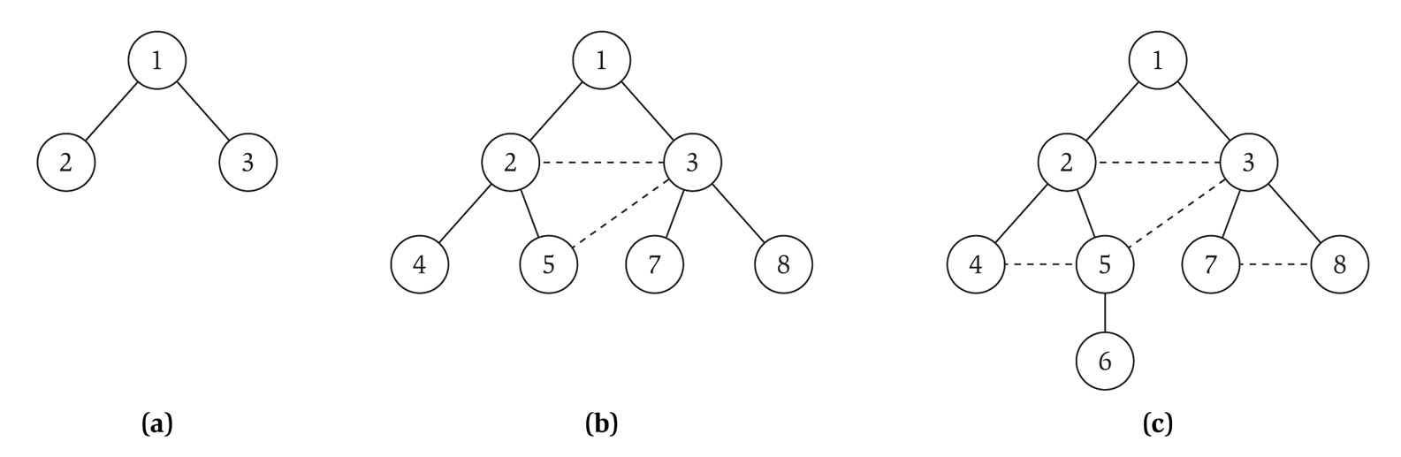
Breadth First Search tree
Property. Let T be a BFS tree of G = (V, E), and let (x, y) be an edge of G. Then the level of x and y differ by at most 1.
L₀
L₁
L₂
L₃

Slide 20
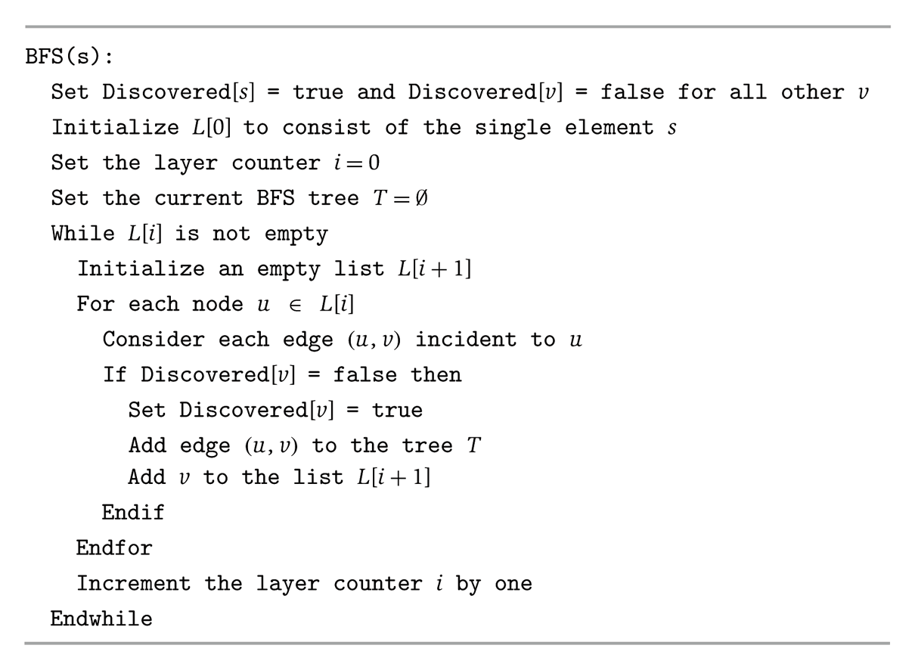
Algorithm 3.3, page 90

Slide 21
Breadth First Search: Analysis
Theorem. The above implementation of BFS runs in O(m + n) time if the graph is given by its adjacency representation.
Pf.
  Easy to prove O(n²) running time:
    at most n lists L[i]
    each node occurs on at most one list; for loop runs ≤ n times
    when we consider node u, there are ≤ n incident edges (u, v),
    and we spend O(1) processing each edge
  Actually runs in O(m + n) time:
    when we consider node u, there are deg(u) incident edges (u, v)
    total time processing edges is Σ_{u∈V} deg(u) = 2m ▪
each edge (u, v) is counted exactly twice
in sum: once in deg(u) and once in deg(v)

Slide 22
Implementing breadth-first search with queue
Question: how to replace all lists with a single queue?

Slide 23
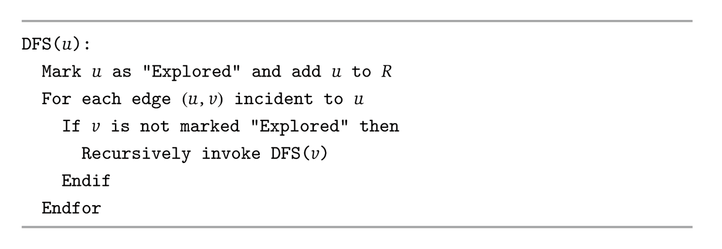
Depth-first search: recursion
Use stack rather than queue (alternately, use recursion)
DFS intuition. Explore outward from s along one path as far as possible, and backtrack when you cannot progress. Effect: find faraway nodes.

Slide 24
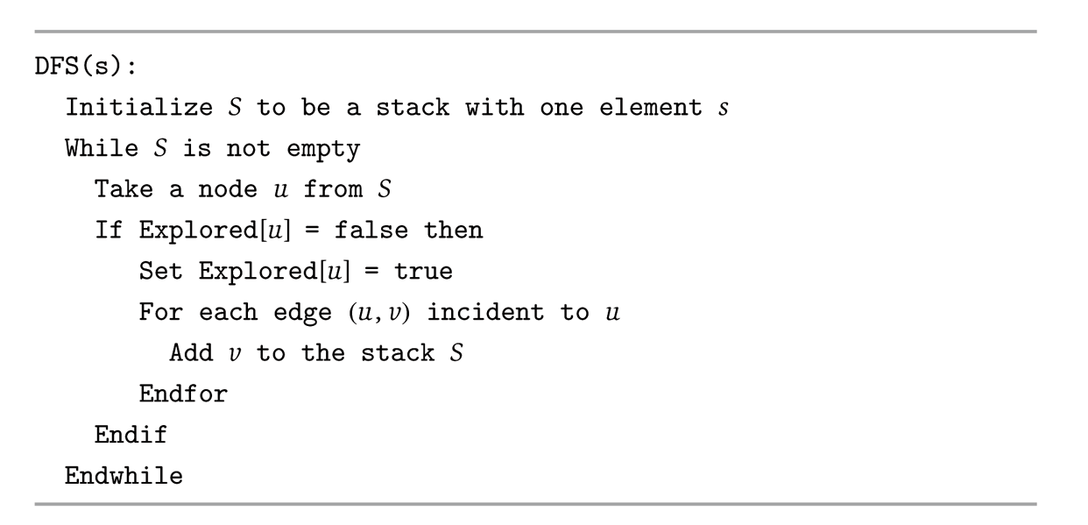
Depth-first search: stack

Slide 25
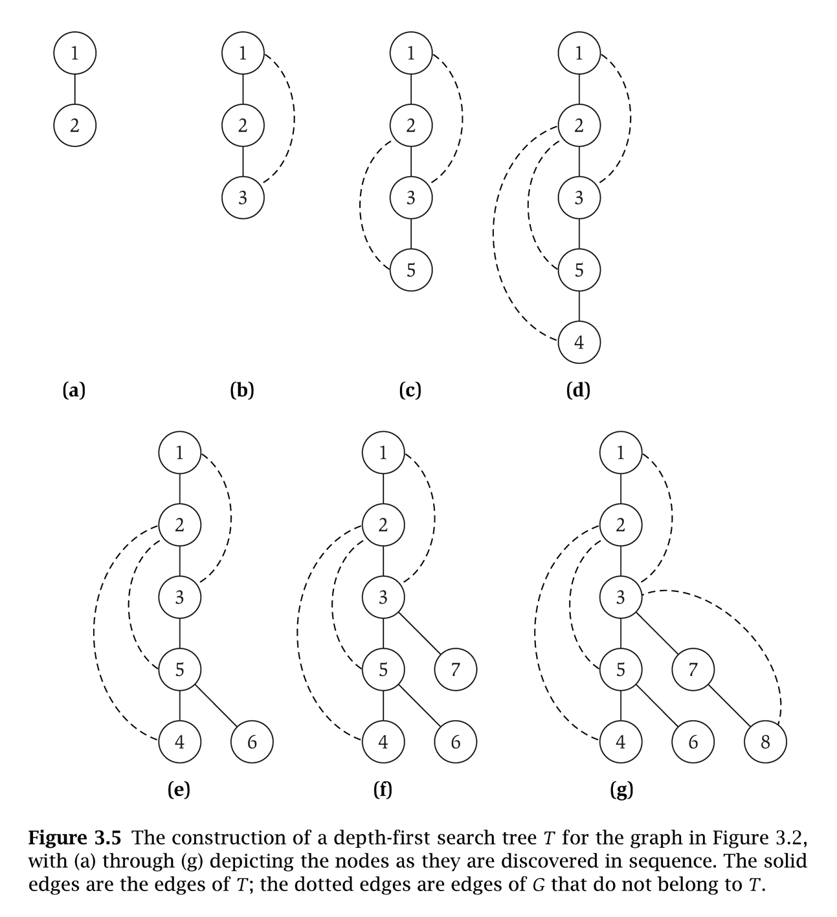

Slide 26
Depth-first search tree
Property. For a given recursive call DFS(u), all nodes marked “Explored” between the beginning and end of this recursive call are descendants of u in T.
Theorem. Let T be a depth-first search tree, let x and y be nodes in T, and let (x,y) be an edge of G that is not an edge of T. Then one of x or y is an ancestor of the other.
DFS/BFS can be extended to the case when there is no specified source. Results in search forest rather than search tree.

Slide 27
Connected Component
Connected component. Find all nodes reachable from s.
Connected component containing node 1 = { 1, 2, 3, 4, 5, 6, 7, 8 }.

Slide 28

Flood Fill
Flood fill. Given lime green pixel in an image, change color of entire blob of neighboring lime pixels to blue.
  Node: pixel.
  Edge: two neighboring lime pixels.
  Blob: connected component of lime pixels.
recolor lime green blob to blue

Slide 29

Flood Fill
Flood fill. Given lime green pixel in an image, change color of entire blob of neighboring lime pixels to blue.
  Node: pixel.
  Edge: two neighboring lime pixels.
  Blob: connected component of lime pixels.
recolor lime green blob to blue

Slide 30
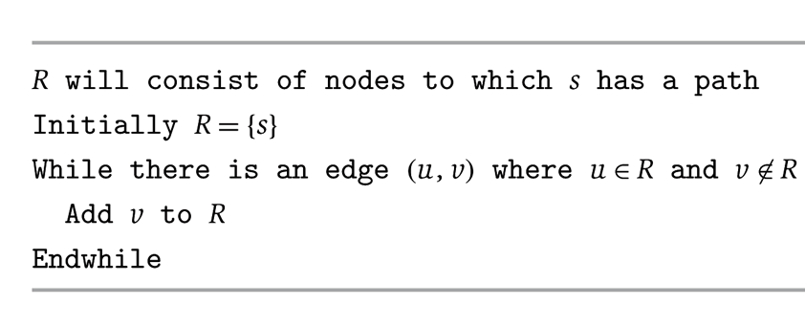
Connected Component
Connected component. Find all nodes reachable from s.
Theorem. Upon termination, R is the connected component containing s.
  BFS = explore in order of distance from s.
  DFS = explore in a different way.
R
s
u
v
it's safe to add v

Slide 31
3.4 Testing Bipartiteness

Slide 32
Bipartite Graphs
Def. An undirected graph G = (V, E) is bipartite if the nodes can be colored red or blue such that every edge has one red and one blue end.
Applications.
  Stable marriage: men = red, women = blue.
  Scheduling: machines = red, jobs = blue.
a bipartite graph

Slide 33
Testing Bipartiteness
Testing bipartiteness. Given a graph G, is it bipartite?
  Many graph problems become:
    easier if the underlying graph is bipartite (matching)
    tractable if the underlying graph is bipartite (independent set)
  Before attempting to design an algorithm, we need to understand structure of bipartite graphs.
v₂
v₂
v₃
v₁
v₄
v₆
v₅
v₄
v₃
v₅
v₆
v₇
v₁
v₇
a bipartite graph G
another drawing of G

Slide 34
An Obstruction to Bipartiteness
Lemma. If a graph G is bipartite, it cannot contain an odd length cycle.
Pf. Not possible to 2-color the odd cycle, let alone G.
bipartite
(2-colorable)
not bipartite
(not 2-colorable)

Slide 35
Bipartite Graphs
Lemma. Let G be a connected graph, and let L₀, …, L_{k} be the layers produced by BFS starting at node s. Exactly one of the following holds.
  (i) No edge of G joins two nodes of the same layer, and G is bipartite.
  (ii) An edge of G joins two nodes of the same layer, and G contains an
  odd-length cycle (and hence is not bipartite).
L₁
L₂
L₃
L₁
L₂
L₃
Case (i)
Case (ii)

Slide 36
Bipartite Graphs
Lemma. Let G be a connected graph, and let L₀, …, L_{k} be the layers produced by BFS starting at node s. Exactly one of the following holds.
  (i) No edge of G joins two nodes of the same layer, and G is bipartite.
  (ii) An edge of G joins two nodes of the same layer, and G contains an
  odd-length cycle (and hence is not bipartite).
Pf. (i)
  Suppose no edge joins two nodes in the same layer.
  Bipartition: red = nodes on odd levels, blue = nodes on even levels.
L₁
L₂
L₃
Case (i)

Slide 37
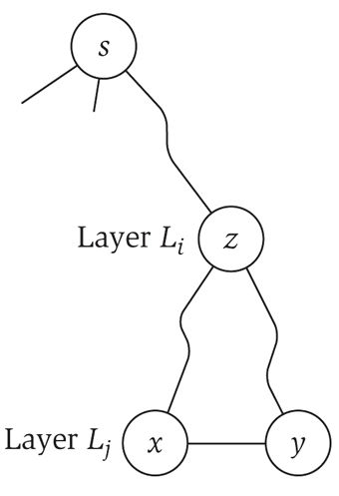
Bipartite Graphs
Lemma. Let G be a connected graph, and let L₀, …, L_{k} be the layers produced by BFS starting at node s. Exactly one of the following holds.
  (i) No edge of G joins two nodes of the same layer, and G is bipartite.
  (ii) An edge of G joins two nodes of the same layer, and G contains an
  odd-length cycle (and hence is not bipartite).
Pf. (ii)
  Suppose (x, y) is an edge with x, y in same level L_{j}.
  Let z = lca(x, y) = lowest common ancestor.
  Let L_{i} be level containing z.
  Consider cycle that takes edge from x to y,
  then path from y to z, then path from z to x.
  Its length is 1 + (j-i) + (j-i), which is odd. ▪
z = lca(x, y)
(x, y)
path from
y to z
path from
z to x

Slide 38
Obstruction to Bipartiteness
Corollary. A graph G is bipartite iff it contain no odd length cycle.
5-cycle C
bipartite
(2-colorable)
not bipartite
(not 2-colorable)

Slide 39
3.5 Connectivity in Directed Graphs

Slide 40
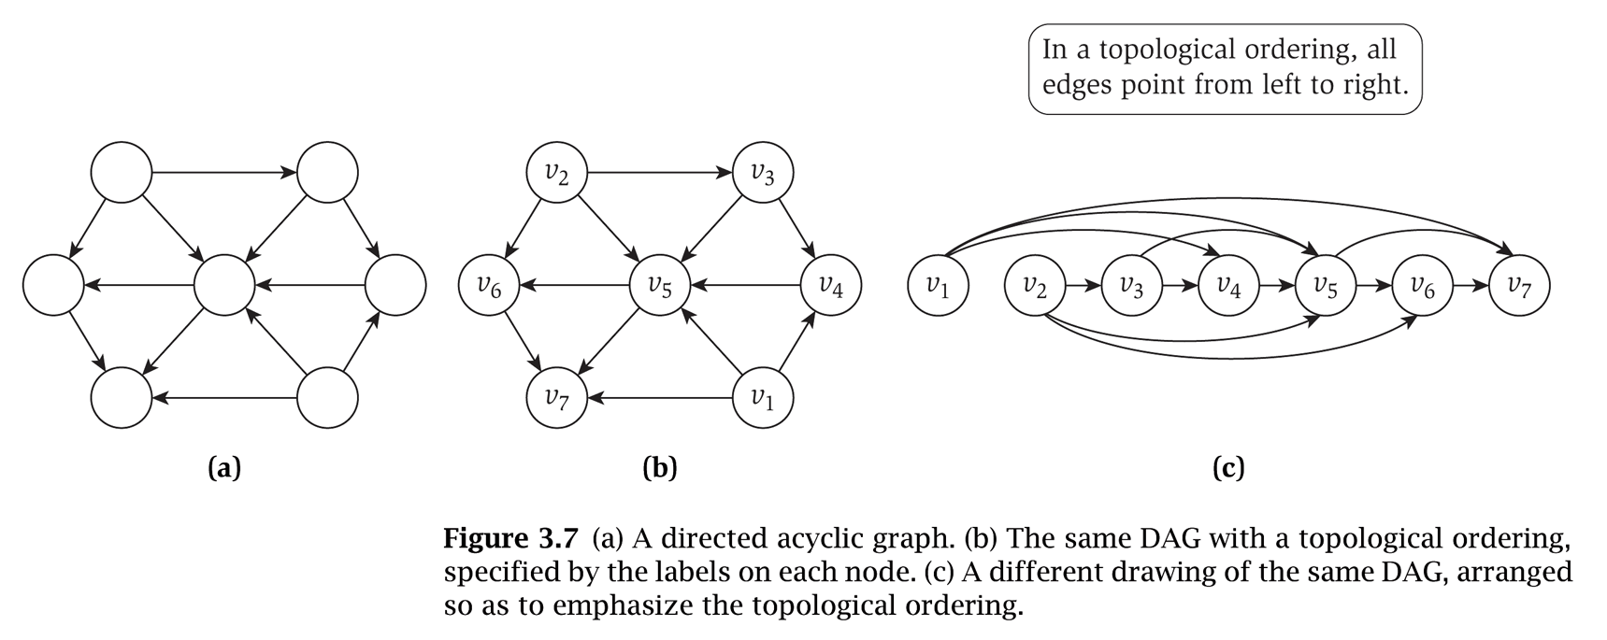
Directed Graphs
Directed graph. G = (V, E)
  Edge (u, v) goes from node u to node v.
Ex. Web graph - hyperlink points from one web page to another.
  Directedness of graph is crucial.
  Modern web search engines exploit hyperlink structure to rank web pages by importance.

Slide 41
Graph Search
Directed reachability. Given a node s, find all nodes reachable from s.
Directed s-t shortest path problem. Given two node s and t, what is the length of the shortest path between s and t?
Graph search. BFS extends naturally to directed graphs.
Web crawler. Start from web page s. Find all web pages linked from s, either directly or indirectly.

Slide 42
Strong Connectivity
Def. Node u and v are mutually reachable if there is a path from u to v and also a path from v to u.
Def. A graph is strongly connected if every pair of nodes is mutually reachable.
Lemma. Let s be any node. G is strongly connected iff every node is reachable from s, and s is reachable from every node.
Pf. ⇒ Follows from definition.
Pf. ⇐ Path from u to v: concatenate u-s path with s-v path.
Path from v to u: concatenate v-s path with s-u path. ▪
ok if paths overlap
s
u
v
Notes:
Theorem. [Tarjan 1972] Can decompose a graph into its
"strong components" in O(m + n) time.

Slide 43
Strong Connectivity: Algorithm
Theorem. Can determine if G is strongly connected in O(m + n) time.
Pf.
  Pick any node s.
  Run BFS from s in G.
  Run BFS from s in G^{rev}.
  Return true iff all nodes reached in both BFS executions.
  Correctness follows immediately from previous lemma. ▪
reverse orientation of every edge in G
strongly connected
not strongly connected
Notes:
Theorem. [Tarjan 1972] Can decompose a graph into its
"strong components" in O(m + n) time.

Slide 44
3.6 DAGs and Topological Ordering

Slide 45
Directed Acyclic Graphs
Def. An DAG is a directed graph that contains no directed cycles.
Ex. Precedence constraints: edge (v_{i}, v_{j}) means v_{i} must precede v_{j}.
Def. A topological order of a directed graph G = (V, E) is an ordering of its nodes as v₁, v₂, …, v_{n} so that for every edge (v_{i}, v_{j}) we have i < j.
v₂
v₃
v₆
v₅
v₄
v₁
v₂
v₃
v₄
v₅
v₆
v₇
v₇
v₁
a DAG
a topological ordering

Slide 46
Precedence Constraints
Precedence constraints. Edge (v_{i}, v_{j}) means task v_{i} must occur before v_{j}.
Applications.
  Course prerequisite graph: course v_{i} must be taken before v_{j}.
  Compilation: module v_{i} must be compiled before v_{j}.
  Pipeline of computing jobs: output of job v_{i} needed to determine input of job v_{j}.

Slide 47
Directed Acyclic Graphs
Lemma. If G has a topological order, then G is a DAG.
Pf. (by contradiction)
  Suppose that G has a topological order v₁, …, v_{n} and that G also has a directed cycle C. Let's see what happens.
  Let v_{i} be the lowest-indexed node in C, and let v_{j} be the node just before v_{i}; thus (v_{j}, v_{i}) is an edge.
  By our choice of i, we have i < j.
  On the other hand, since (v_{j}, v_{i}) is an edge and v₁, …, v_{n} is a topological order, we must have j < i, a contradiction. ▪
the directed cycle C
v₁
v_{i}
v_{j}
v_{n}
the supposed topological order: v₁, …, v_{n}

Slide 48
Directed Acyclic Graphs
Lemma. If G has a topological order, then G is a DAG.
Q. Does every DAG have a topological ordering?
Q. If so, how do we compute one?

Slide 49
Directed Acyclic Graphs
Lemma. If G is a DAG, then G has a node with no incoming edges.
Pf. (by contradiction)
  Suppose that G is a DAG and every node has at least one incoming edge. Let's see what happens.
  Pick any node v, and begin following edges backward from v. Since v has at least one incoming edge (u, v) we can walk backward to u.
  Then, since u has at least one incoming edge (x, u), we can walk backward to x.
  Repeat until we visit a node, say w, twice.
  Let C denote the sequence of nodes encountered between successive visits to w. C is a cycle. ▪
w
x
u
v

Slide 50
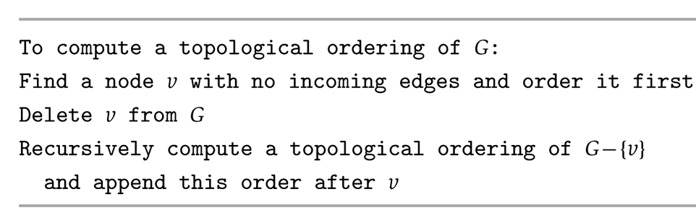
Directed Acyclic Graphs
Lemma. If G is a DAG, then G has a topological ordering.
Pf. (by induction on n)
  Base case: true if n = 1.
  Given DAG on n > 1 nodes, find a node v with no incoming edges.
  G - { v } is a DAG, since deleting v cannot create cycles.
  By inductive hypothesis, G - { v } has a topological ordering.
  Place v first in topological ordering; then append nodes of G - { v }
  in topological order. This is valid since v has no incoming edges. ▪
DAG
v

Slide 51
Topological Sorting Algorithm: Running Time
Theorem. Algorithm finds a topological order in O(m + n) time.
Pf.
  Maintain the following information:
    count[w] = remaining number of incoming edges
    S = set of remaining nodes with no incoming edges
  Initialization: O(m + n) via single scan through graph.
  Update: to delete v
    remove v from S
    decrement count[w] for all edges from v to w, and add w to S if c count[w] hits 0
    this is O(1) per edge ▪
Notes:
Alternative. Order nodes in reverse order that DFS finishes visiting them.

